Slide 1
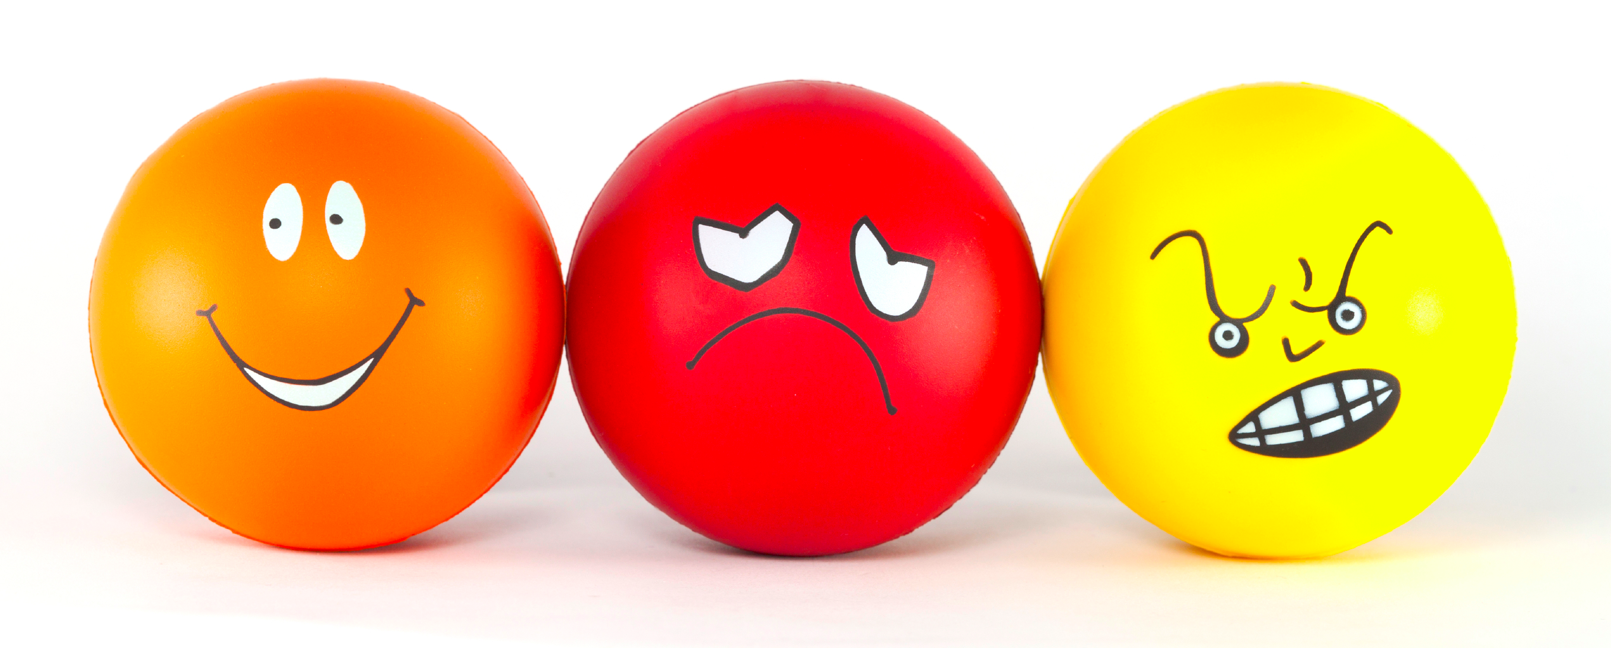
Generating Emotional Impact in Stories
Lydia Chilton, Stanford University
Jessica Ouyang, Columbia University
6 April 2015

Slide 2
Emotional impact is the magic of storytelling.
Notes:
Goes beneath the surface of the facts and to affect people in ways they remember.

Slide 3
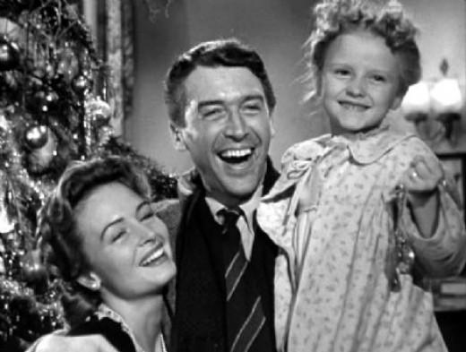
Notes:
As cheesy as they are, people love a happy ending

Slide 4
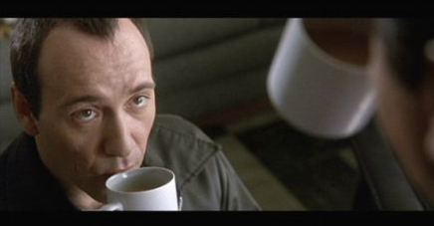
Notes:
There’s a thrill at a surprise twist

Slide 5
Emotions drive us to actions.
Notes:
Quite simply, emotional impact is the magic of story telling.

Slide 6

Hunger drives us to seek food.

Slide 7
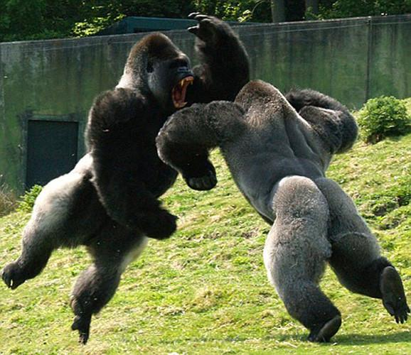
Anger drives us to fight.

Slide 8

Confusion drives us to ask questions.

Slide 9
Emotion drives information seeking behavior.
Notes:
Quite simply, emotional impact is the magic of story telling.

Slide 10
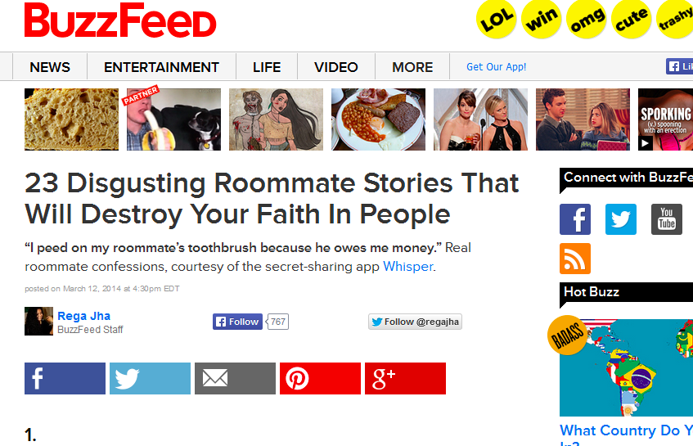
Notes:
A lot of media drives negative behavior. Anger seems easier to trigger than Happyness.

Slide 11


Slide 12
If we can understand emotional impact,
we can create media that is compelling
and drives us to take action.

Slide 13





Method
Domain: News Satire
collect theories of
emotional impact
Test the usefulness of theories by having people generate humor.
Test correctness of
theories against data
Notes:
Loop back from testing usefulness to improving modesl
Add a line about deliverables

Slide 14
Generating News Satire
Notes:
Quite simply, emotional impact is the magic of story telling.

Slide 15
Models of Humor
Insult
Exaggeration
Reversal
Truth
Pain

Slide 16
2-Script Theory of Humor
Raskin 1987
Two stories/scripts interpreted simultaneous or in quick succession
“I married Miss Right. I didn’t know her first name was always.”
Script 1: (Positive) He married Miss Right
Script 2: (Negative) His wife nags him.

Slide 17
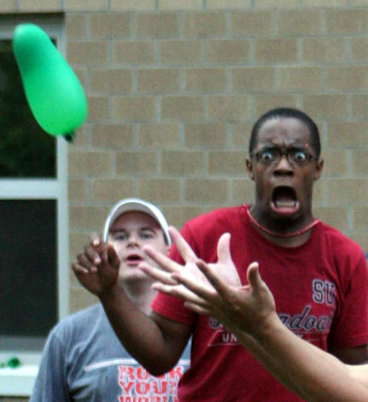
We laugh at people, not things.

Slide 18
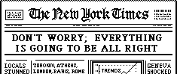
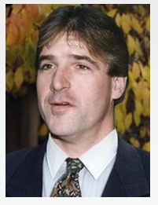
News Satire
Headline
Montana Lawmaker Proposes Banning Yoga Pants
Point of view
reversal
criticism
All that bill would do is require me to use my imagination more.
reason
Joke

Slide 19
Applying Humor Theories
Find a criticism of a person in the headline
Find “Two Scripts”:
Script 1: Takes the point of view of the person being criticized.
Script 2: (often the criticism)

Slide 20
Montana Lawmaker Proposes Banning Yoga Pants
Person to criticize
Montana Lawmaker
Aspect to criticize
[The law would] expand indecent exposure laws to include tight-fighting clothing.
What to criticize
Too extreme. Yoga pants are not indecent exposure
You have to use your imagination to see anything
Expected Reaction
Expected Reason
Expectation Reaction
Reversal
Reason
POV
Pervert
Dislike
Won’t be able to perv anymore
Like. He will still be able to perv
He will have to get to use his imagination more.
Script 1
Script 2
All that bill would do is require me to use my imagination more.

Slide 21
Met Museum Bans ‘Selfie-Stick’
Person to criticize
Met
Aspect to criticize
Ban Selfie-sticks because they invade guests’ personal space.
What to criticize
Too extreme.
They aren’t bothersome enough to ban.
Expected Reaction
Expected Reason
Expectation Reaction
Reversal
Reason
POV
Botherer
Dislike
Won’t be able to bother anymore
Like. He will still bother people.
Find another way.
Script 1
Script 2
That’s all right. I don’t need a selfie-stick to bother people at a museum.
Notes:
Connecting the criticism with the second story.

Slide 22
Emotional Analysis
Positive
Sentiment
Point of View 1
Montana Lawmaker
Met Museum
Point of View 2
Pervert
Botherer
Negative
Sentiment
Headline
Joke
Headline
Joke
…bans yoga pants.
…bans selfie-stick
…use my imagination more.
…don’t need a selfie-stick.

Slide 23
Emotional Analysis: Beneath the Surface
Positive
Sentiment
Point of View 1
Montana Lawmaker
Met Museum
Point of View 2
Pervert
Botherer
Negative
Sentiment
Headline
Won’t be able to bother anymore
Joke
Botherer
Dislike
Like. He will still bother
Find another way.
…bans yoga pants.
…bans selfie-stick
…use my imagination more.
…don’t need a selfie-stick.

Slide 24
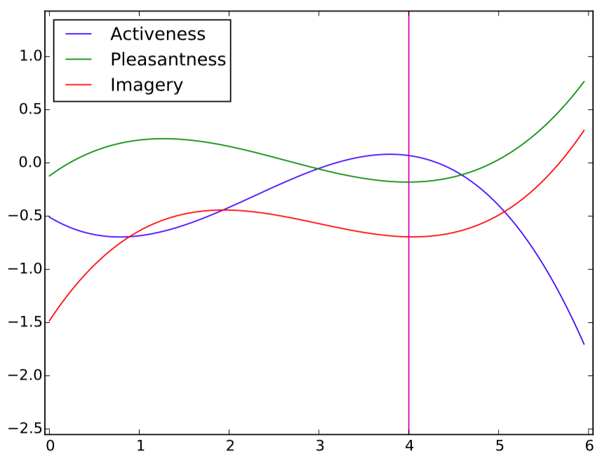
Spline Modeling
Dictionary of Affect in Language Score
Sentence Index

Slide 25
Dramatic Personal Narratives

Slide 26
Theories of Dramatic Narrative
A minimal story consists of a starting state, an ending state, and an event that causes this change of state.
A Grammar of Stories: An Introduction, Gerald Prince 1973
To hold an audience’s attention, a personal narrative must contain a Most Reportable Event (MRE), an event that is uncommon and highly impactful
‘Some Further Steps in Narrative Analysis’, William Labov 1997
Notes:
Are they quotes?

Slide 27
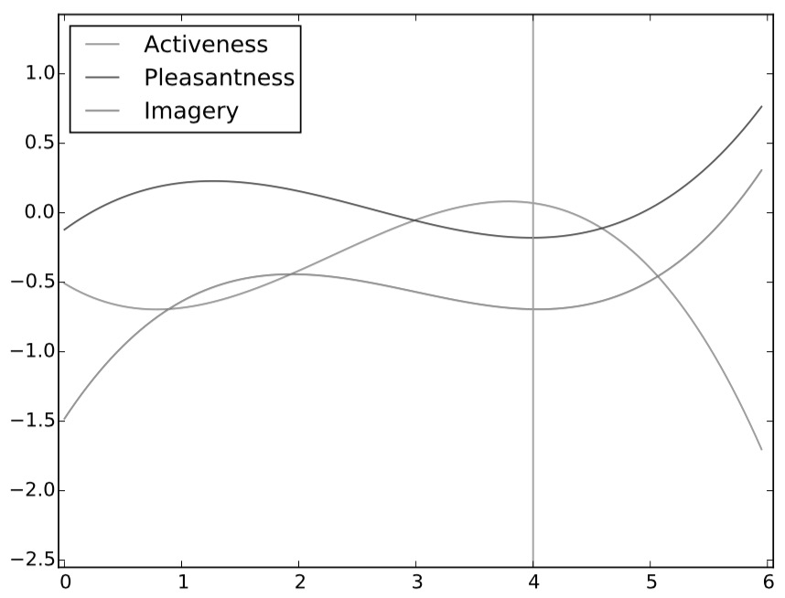
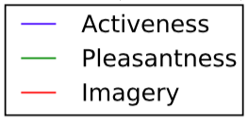
Example of Spline Modeling
Dictionary of Affect in Language Score
Sentence Index

Slide 28
Example of Spline Modeling
Dictionary of Affect in Language Score
This isn't exactly creepy, but it's one of the scariest things that's ever happened to me.
Sentence Index

Slide 29
Example of Spline Modeling
Dictionary of Affect in Language Score
I was driving down the motorway with my boyfriend in the passenger seat, and my dad in the seat behind my own.
Sentence Index

Slide 30
Example of Spline Modeling
Dictionary of Affect in Language Score
My dad is an epileptic and his fits are extremely sporadic.
Sentence Index

Slide 31
Example of Spline Modeling
Dictionary of Affect in Language Score
Sometimes he goes extremely stiff and other times he will try to get out of places or grab and punch people.
Sentence Index

Slide 32
Example of Spline Modeling
Dictionary of Affect in Language Score
Mid-conversation I felt his hands wrap around my throat as I was driving, pulling my head back and making it increasingly difficult to drive.
Sentence Index

Slide 33
Example of Spline Modeling
Dictionary of Affect in Language Score
My boyfriend managed to help steer the car into the hard shoulder but it was one of the scariest experiences in my life.
Sentence Index

Slide 34
Testing Theories of Dramatic Narrative
Data
3,161 narratives from Reddit
2692 narratives labeled with MREs
Experiments
Trained a machine learning model
SVM
Distant learning
Self-learning
Achieves high recall (0.92) but low precision (0.38)

Slide 35
Deliverables
Website/App for people to participate in generating humor from our models
Users analyze humor
Users follow patterns and create humor
Improve model
Improvements to model based on spline modeling on emotional content
Videos of the research explaining how to go “Beneath the surface”

Slide 36
Timeline
Apply sentiment
classification
Detect Sarcasm
Revise with new data
Apply MREs
To humor data
Apply attitude
targets
Derive blame/
criticism
Sept
Nov
Jan
Mar
May
July
Aug-Sept
Generalize
To Headline
Satire
Analyzing Humor
2-Scripts/Premises
Publicize
Judging Humor
Identify criticisms
Improving Theory
Notes:
IMPROVE!!!!

Slide 37
Summary
Computers don’t understand emotional impact.
Teach people a method of generating humor while helping computers understand language.
If we can understand emotional impact, we can
create media that is compelling and drives us to
tell our friends and find out more.
Notes:
Computers don’t understand emotional impact.
They don’t understand things “beneath the surface.”
Help people generate humor from models while helping computers understand language.
If we can understand emotional impact, we can
Create media that is compelling and drives us to take action.

